Slide 1

Present Your Data- Driven Insights

Slide 2
Objectives
Learn how to structure and build your data-findings report.
Explain the basic contents of the outline
Show some notes when making a present report
Finding and Present Your Results

Slide 3
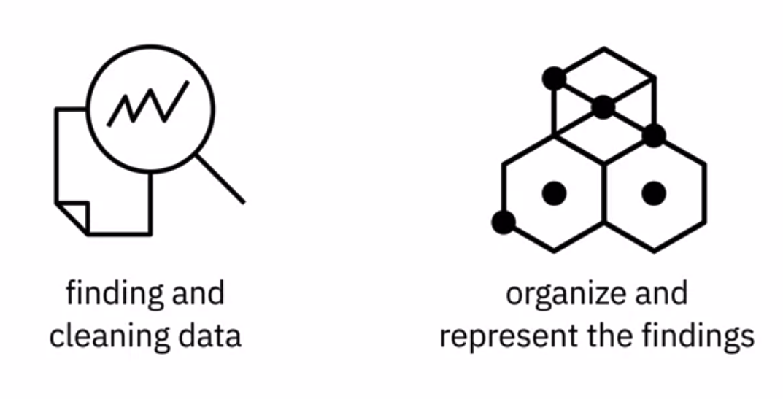
Introduction
Finding and cleaning data is an important first step in data analysis→ help organize and represent the findings effectively
Finding and Present Your Results

Slide 4
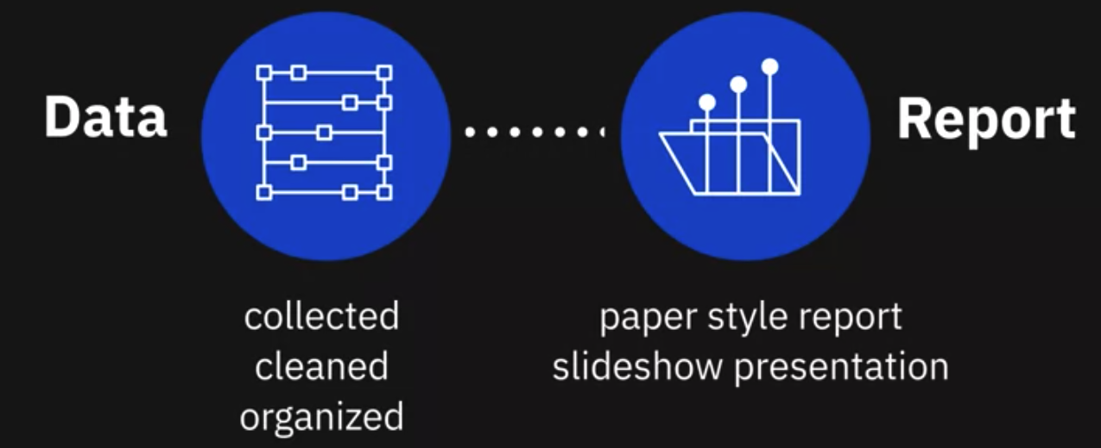
Introduction
The findings report is a crucial part of data analysis--> conveys what was discovered
Finding and Present Your Results

Slide 5
Introduction
After the data has been collected, cleaned, and organized the work of interpretation begins.
You are now able to obtain a complete view of the data and hopefully, answer the questions that were formed before starting the analysis.
Your report could vary in form: paper style report, a slideshow presentation, or maybe even both.
Finding and Present Your Results

Slide 6
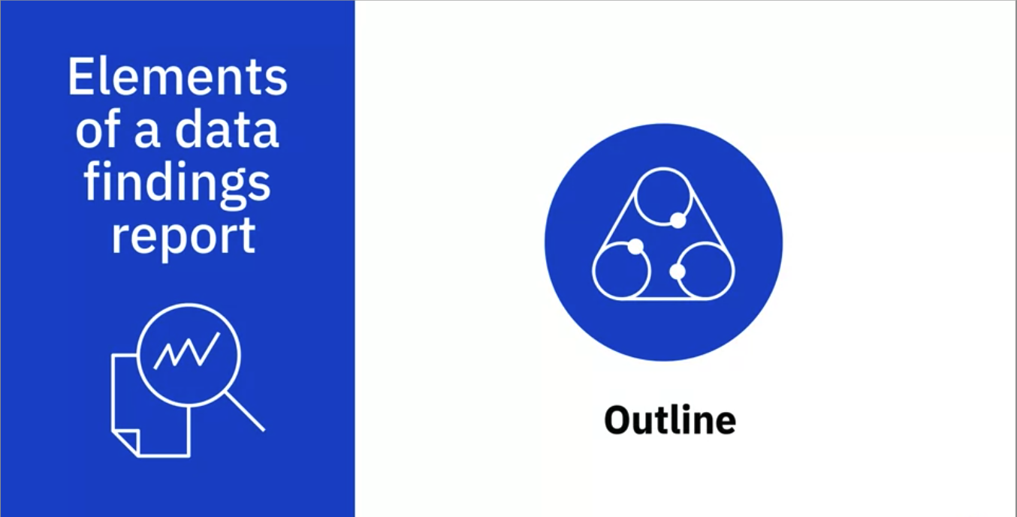
Finding report
Outline: get a complete picture and begin to write in a precise but simple manner.
Finding and Present Your Results

Slide 7
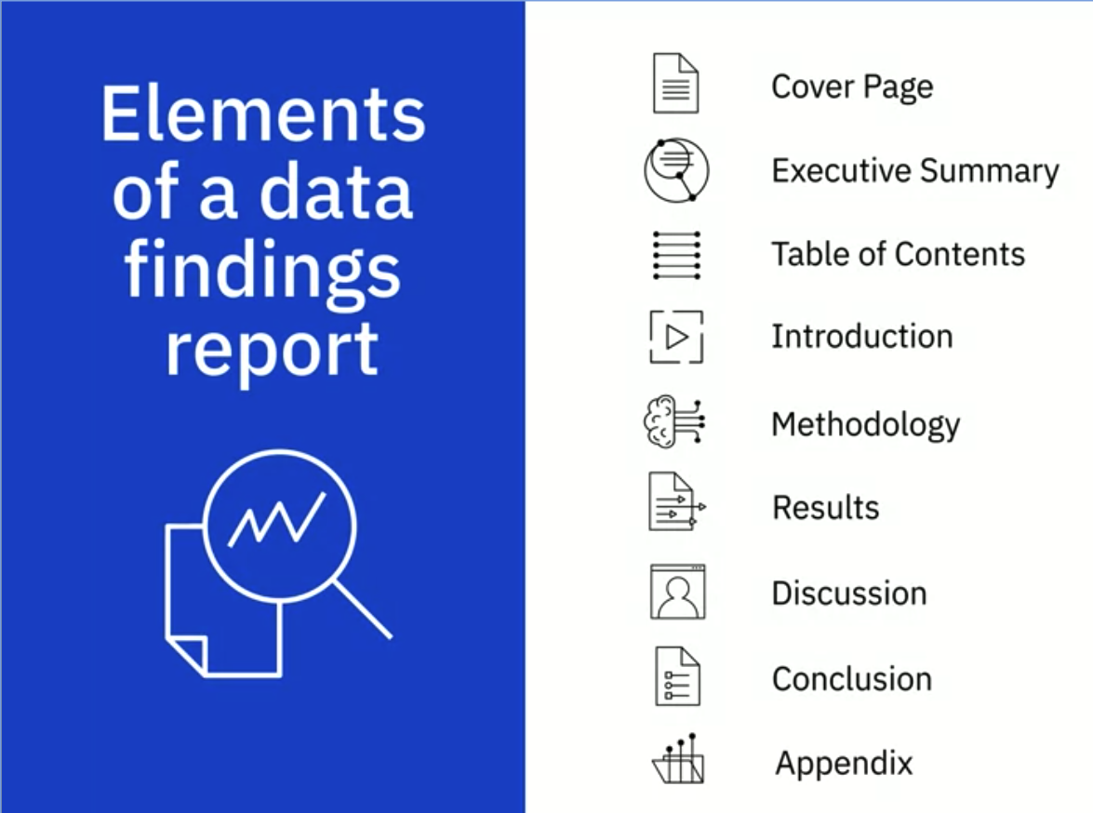
Finding report
Ouline structure
Finding and Present Your Results
Notes:
You first begin with your cover page.
This beginning section will have the title of your presentation, your name, and then
the date.
The next section in your outline will be an executive summary and then the table of contents.
The table of contents will contain the sections and subsections of your report in order to
give your audience an overview of the contents.
This also enables readers to go directly to a specific section that may be more important
to them.
Continue your presentation with the introduction, methodology, results, discussion, conclusion,
and finally the appendix.

Slide 8
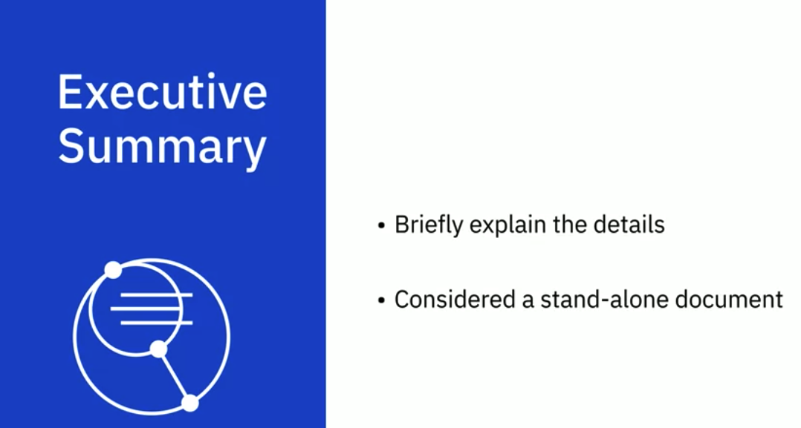
Finding report
Executive Summary section: main point of the report: why?
Finding and Present Your Results
Notes:
This summary will briefly explain the details of the project and should be considered a
stand-alone document.
This information is taken from the main points of your report and while it is acceptable
to repeat information, no new information is presented

Slide 9
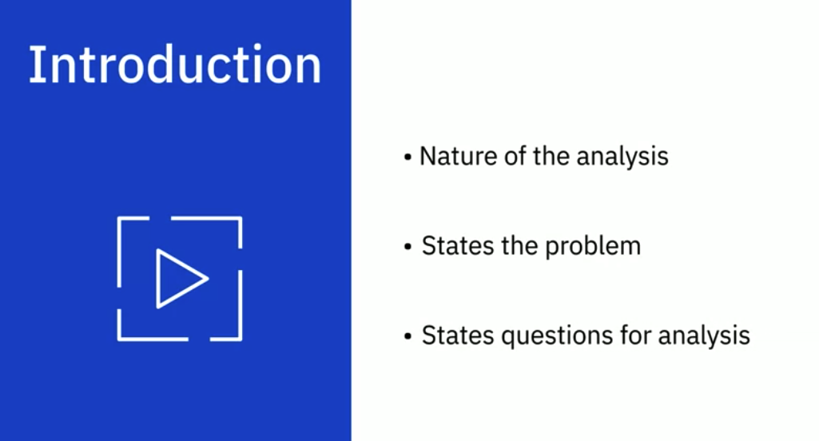
Finding report
Introduction section :
Finding and Present Your Results
Notes:
The introduction explains the nature of the analysis, states the problem, and gives the
questions that were to be answered by performing the analysis.

Slide 10
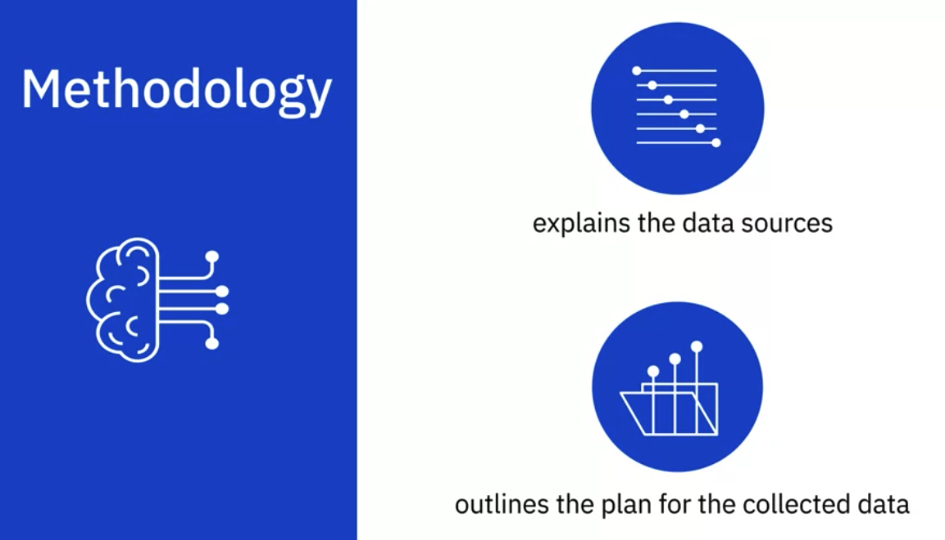
Finding report
Methodology section
Finding and Present Your Results
Notes:
Methodology explains the data sources that were used in the analysis and outlines the
plan for the collected data.
For example, was the cluster or regression method used to analyze the data?

Slide 11
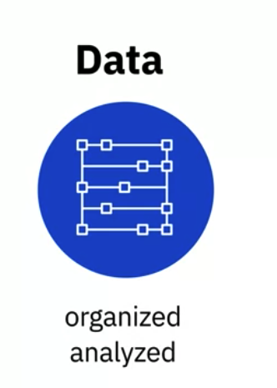

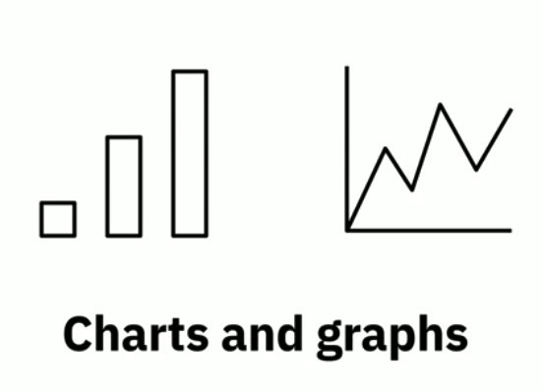
Finding report
Results section
Finding and Present Your Results
Notes:
This section goes into the detail of the data collection, how it was organized, and how
it was analyzed.
This portion would also contain the charts and graphs that would substantiate the results
and call attention to the more complex or crucial findings.

Slide 12

Finding report
Discussion section:
Finding and Present Your Results
Notes:
For this section you would begin to engage the audience with a discussion of your implications
that were drawn from the research.

Slide 13
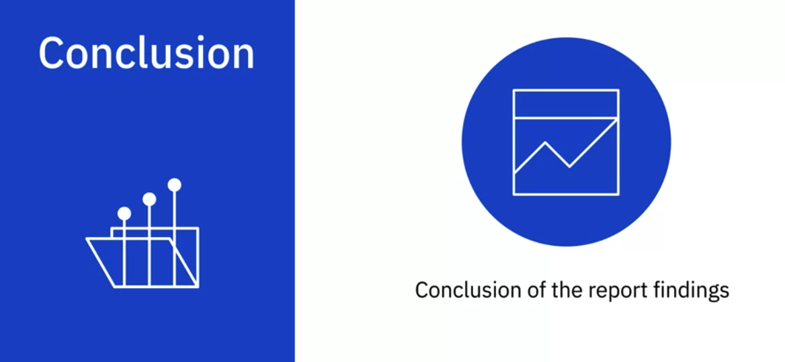
Finding report
Conclusion section
Finding and Present Your Results
Notes:
This final section should reiterate the problem given in the introduction and gives an overall
summary of the findings.

Slide 14
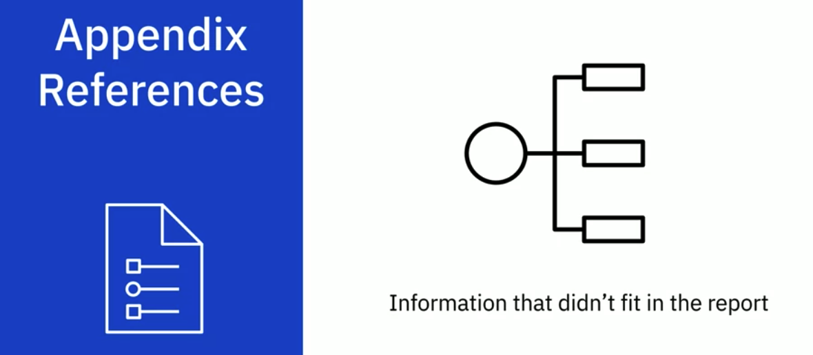
Finding report
Appendix references section
Finding and Present Your Results
Notes:
This section would contain information that really didn’t fit in the main body of the
report, but you deemed it was still important enough to include.
This type of information could include locations where the raw data was collected or other
details such as resources, acknowledgements or references.

Slide 15
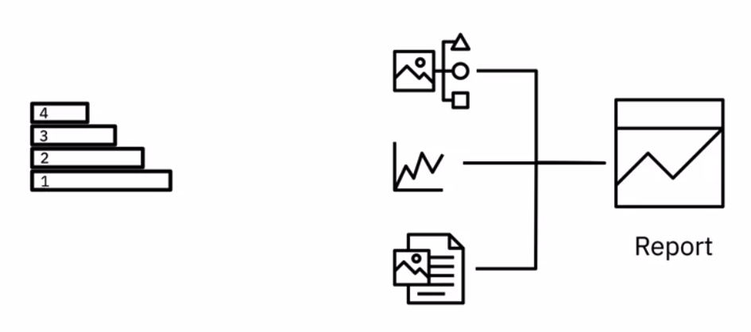
Present your finding
Form the key messages that need to be conveyed to the audience
Build the story around these messages.
Present your data using charts and graphs is the best way to get your message across
Finding and Present Your Results
Notes:
This section would contain information that really didn’t fit in the main body of the
report, but you deemed it was still important enough to include.
This type of information could include locations where the raw data was collected or other
details such as resources, acknowledgements or references.

Slide 16
Summary
Learn how to structure and build your data-findings report.
Explain the basic contents of the outline
Notes when making present report
Finding and Present Your Results

Slide 17
Q & A
Finding and Present Your Results

